Slide 1
Describing people, objects and animals.

Slide 2
Let’s find out about words that show
the opposite meaning. These are called Antonyms
For example:

Slide 3
Look at the following pictures to learn some antonyms.
Can you guess the adjective (επίθετο) and its antonym (αντίθετο) before it appears?

Slide 4
Example:
This cat is …fat…..
thin
This cat is ……..
fat ≠ thin

Slide 5
long
short
This snake is ……..
This snake is ……..
long ≠ short

Slide 6
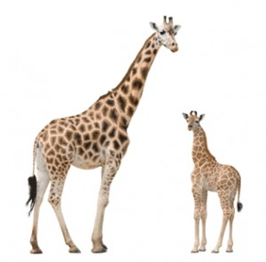
Mummy giraffe is ……..
Baby giraffe is ……..
short
tall
tall ≠ short

Slide 7
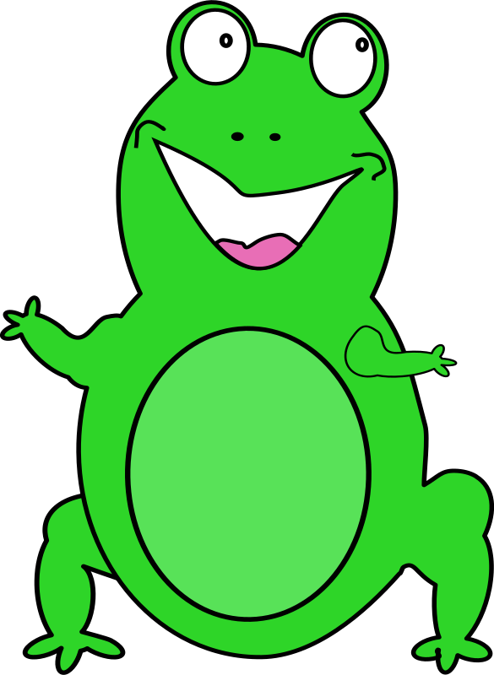
happy
sad
This frog is ……..
This cat is ……..
happy ≠ sad

Slide 8
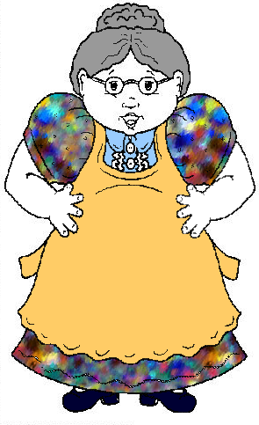
young
old
This woman is ……..
This woman is ……..
young ≠ old

Slide 9
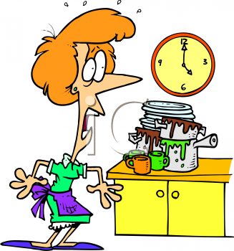
dirty
clean
These dishes are ……..
These dishes are ……..
dirty ≠ clean

Slide 10
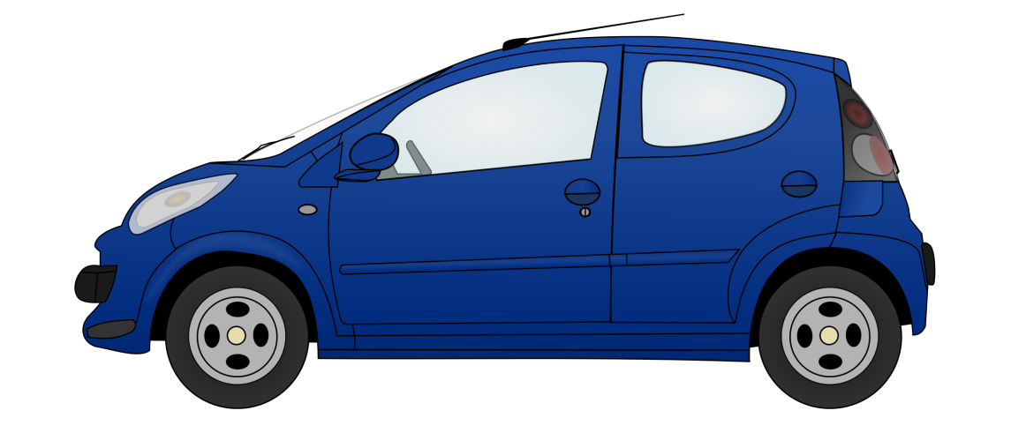
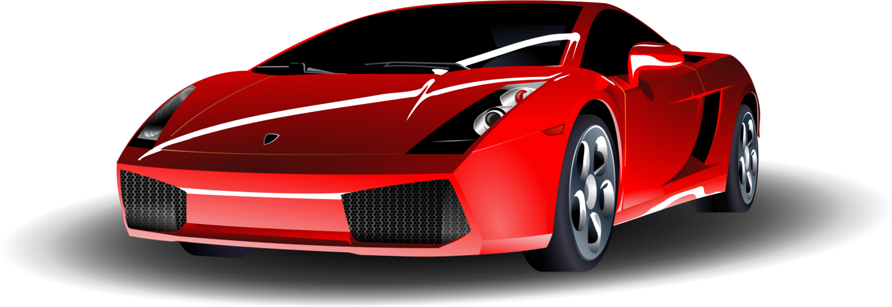
€50 000
€10 000
expensive
cheap
This car is ……..
This car is ……..
expensive ≠ cheap

Slide 11
new
old
This car is ……..
This car is ……..
new ≠ old

Slide 12
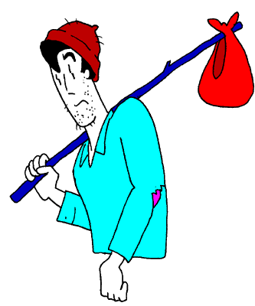
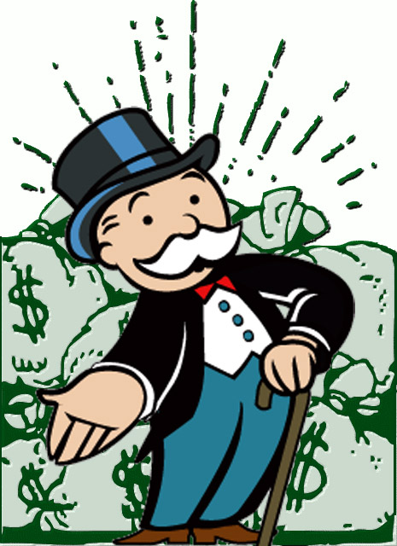
poor
rich
This man is ……..
This man is ……..
poor ≠ rich

Slide 13
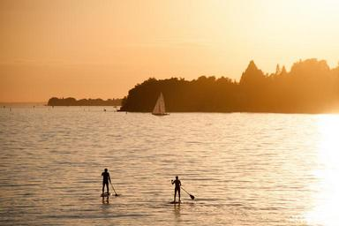
cold
hot
Winter is ……..
Summer is ……..
cold ≠ hot

Slide 14
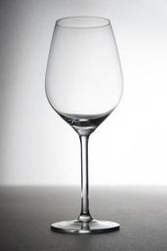
full
empty
This glass is ……..
This glass is ……..
full ≠ empty

Slide 15
Let’s play a matching game.
Click below to match the antonyms
https://wordwall.net/resource/1657588

Slide 16
Watch the following video and try to remember as many antonyms as you can.
https://youtu.be/XPu2tvcvI4o
Now take your exercise book and write as many antonyms as you remember from the video.

Slide 17
1. Read the following text:
2. Now write the story again but use the antonyms.
Once upon a time, there was a beautiful princess. Her name was Carla. She was very rich. She lived in a big castle with her family and had expensive clothes and jewelry. One day she met a prince. He was handsome but very poor. He lived in a small, dirty castle with his family. Carla was very happy when she met the prince. She decided to marry him. They had a nice wedding with many people. They lived happily ever after!
Once upon a time, there was …an ugly…. princess. Her name was Carla. She was very ………. She lived in a …….. castle with her family and had ……………. clothes and jewellery. One day she met a prince. He was …………… but very ………. He lived in a ………., ………….. castle with his family. Carla was very ……….. when she met the prince. She decided to marry him. They had a ……… wedding with many people. They lived ……… ever after!
Use your exercise book to write the story!

Slide 18
Let’s listen to a song.
Click below and listen to the song. Try to remember the antonyms.
https://www.youtube.com/watch?v=HGeuA4iJ8vI
Now take your exercise book and write 5 pairs of antonyms (or more) that you remember from the song.

Slide 19
Let’s watch a story!
Polar Opposites by Eric Brooks
https://www.youtube.com/watch?v=1GLwXMBeMHg
Take your exercise book and make two columns like below.
But first
Alex | Zina
Click below to watch a story about Alex and Zina. Write the antonyms you will find in the story in the right box.

Slide 20
Let’s play a matching game!
Click below and play a game about Alex and Zina.
Match the antonyms.
https://www.quia.com/jg/3113538.html

Slide 21
Let’s be creative!
Can you continue the story about Alex and Zina?
You can write some more sentences in your exercise book.
Then you can draw pictures about them.
OR
You can open a Power Point presentation and make your story there.
Example:
Alex is clean.
Zina is dirty.

Slide 22
Excellent job!

Slide 23
Presentation designed by the English Curriculum Development team,
Cyprus Ministry of Education, Culture, Sports and Youth

