Slide 1

IN THIS LESSON I WILL:
Learn different action verbs
Say what people or animals are doing now
Play some online games
Make a poster
This Photo by Unknown Author is licensed under CC BY

Slide 2
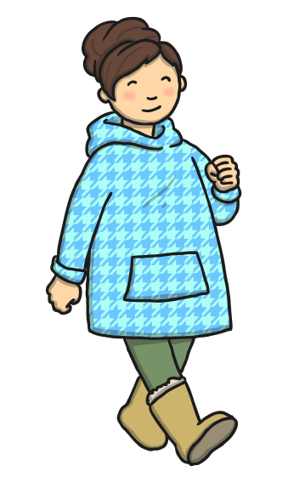
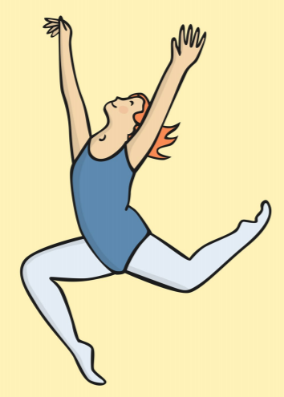
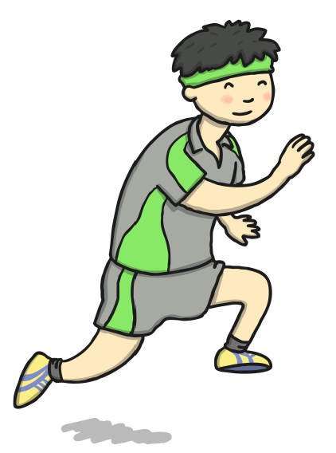

Let’s listen, read and learn some action verbs…
walk
run
jump
dance

Slide 3

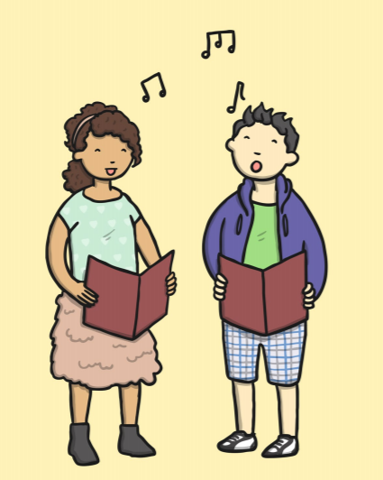
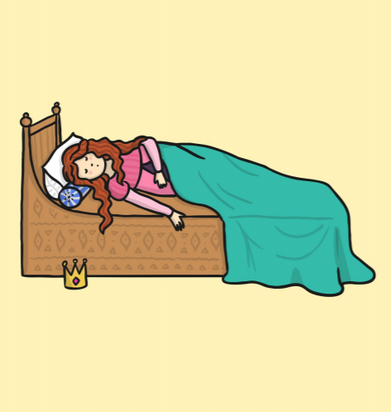
Listen, read and learn
sing
eat
sleep

Slide 4

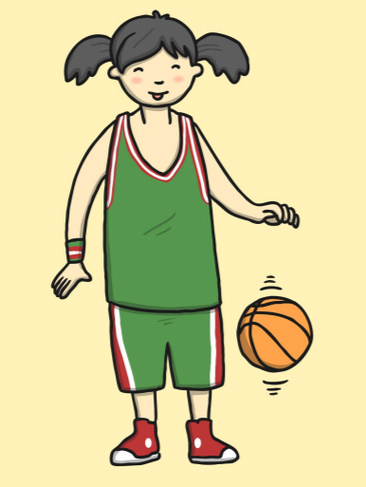

Listen, read and learn
listen
play
fly

Slide 5

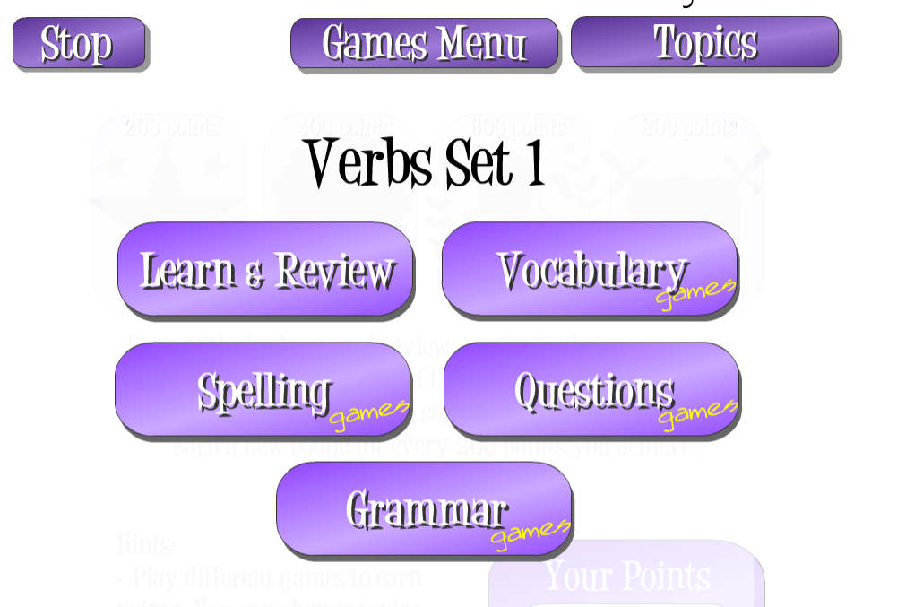
Listen to some more action verbs by clicking the link below.
Repeat after the recording
https://www.mes-games.com/verbs1.php
CLICK HERE
CLICK HERE

Slide 6
Now let’s play a game with action verbs https://wordwall.net/resource/1784899
This Photo by Unknown Author is licensed under CC BY

Slide 7
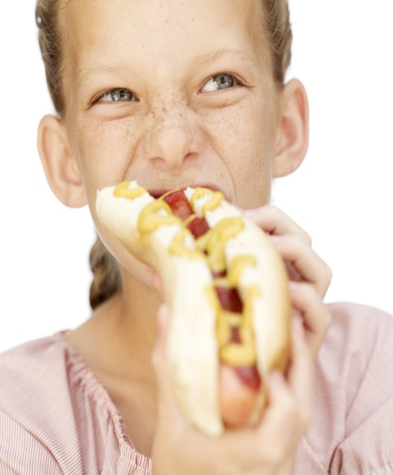
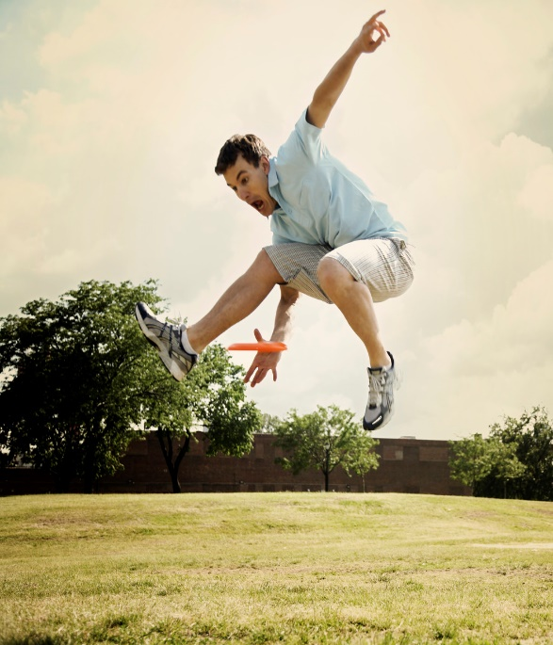
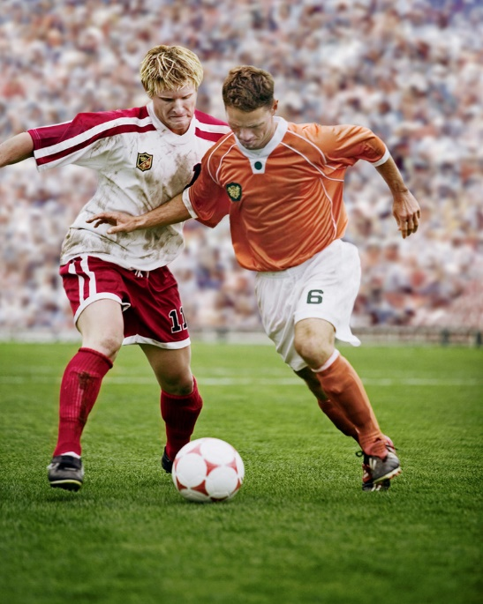
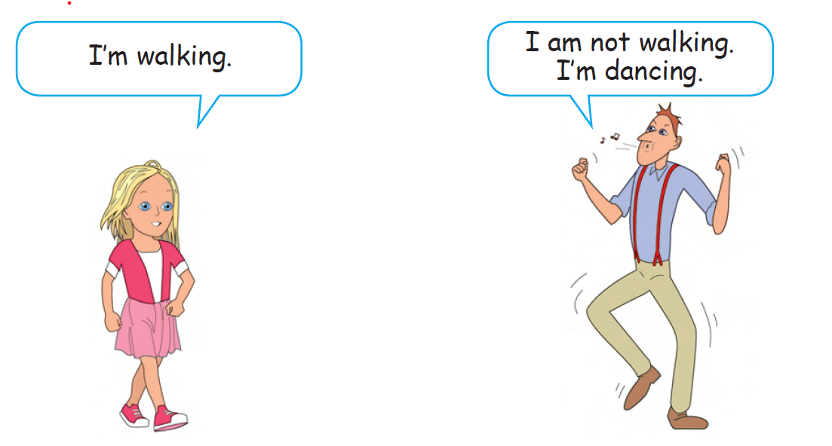
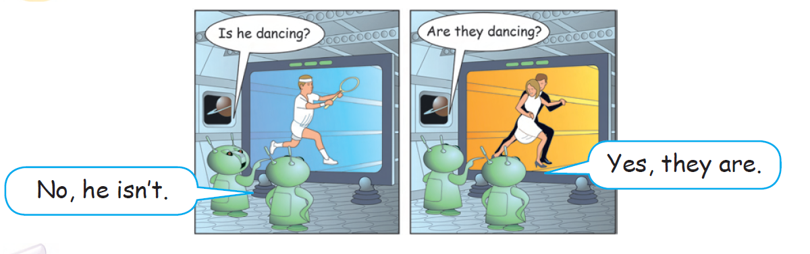
Let ’s remember..
How do I say what people are doing NOW?
(Present Continuous)
She is eating
He is jumping.
They are playing football.

Slide 8
Put the words in the right order to make sentences.
Write your answers in your notebook.
Let ’s practice..
https://wordwall.net/resource/1308679
This Photo by Unknown Author is licensed under CC BY

Slide 9
Now check your answers
The kangaroo is hopping.
The hippos are singing.
We are having dinner now.
She is not having a piano lesson at the moment.
My mum and dad are cooking now.
They are doing their homework.
Maria is watching t.v. at the moment.
This Photo by Unknown Author is licensed under CC BY

Slide 10
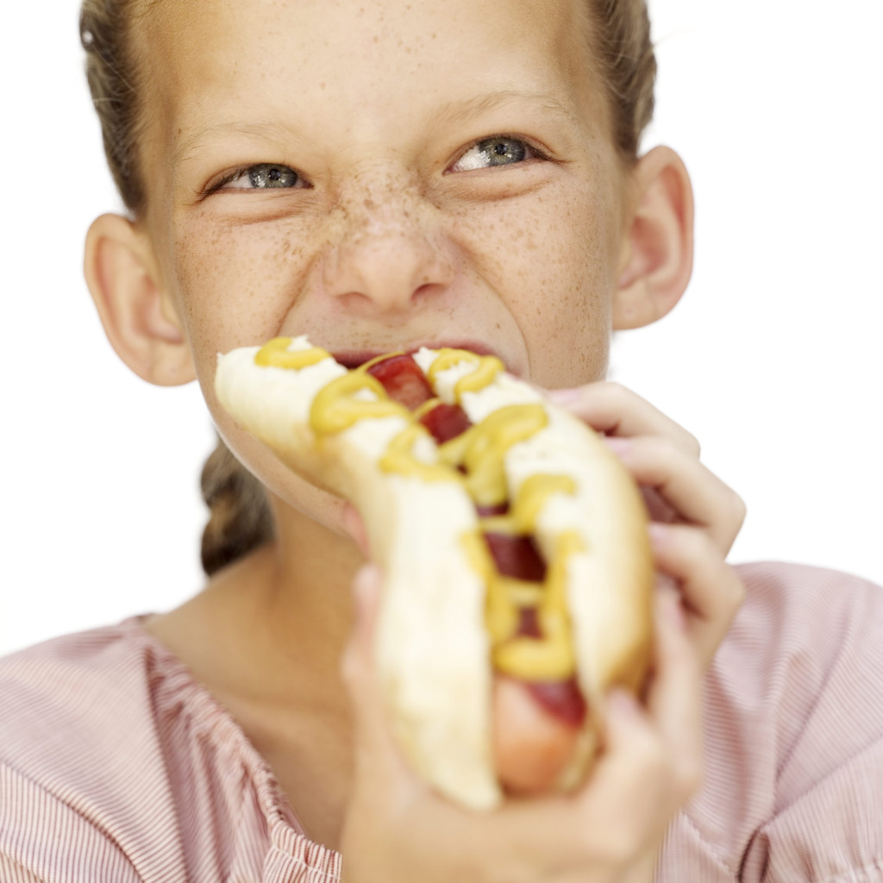
Can you guess? What are the children doing?
Say your answer and then click to see if you are correct :
What is the girl doing?

Slide 11
She is eating.

Slide 12
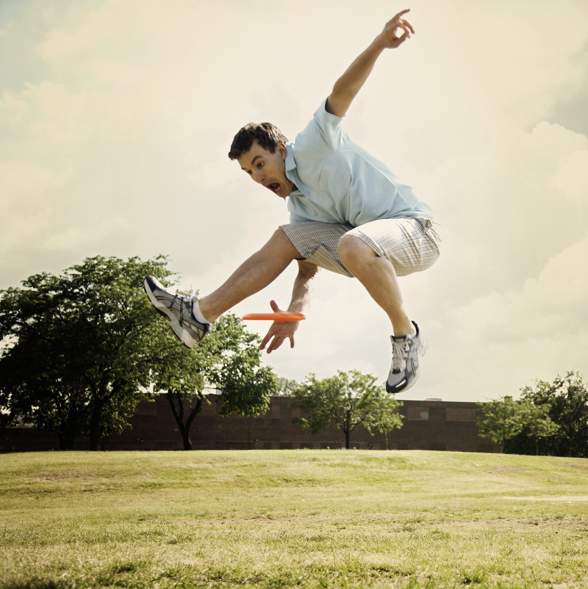
What is the boy doing?

Slide 13
He is jumping.

Slide 14
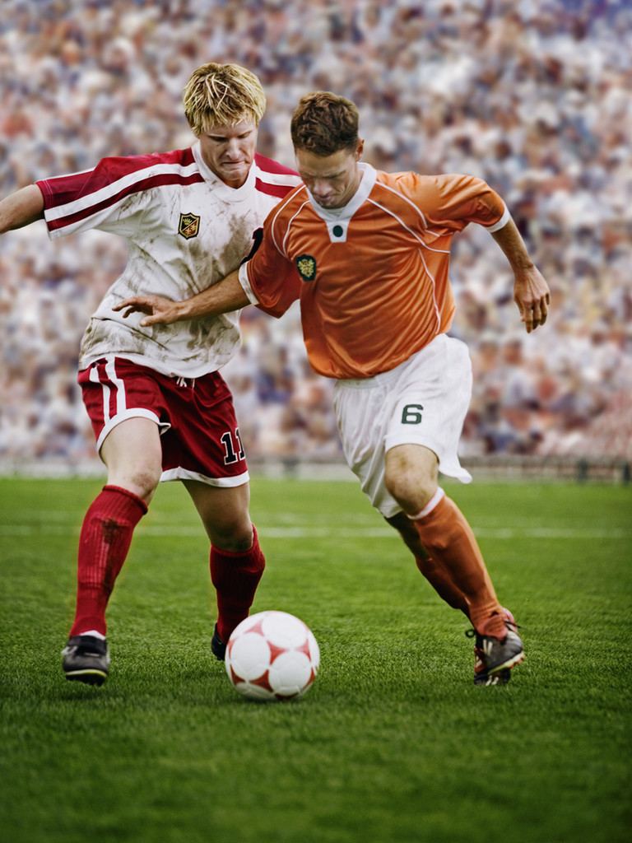
What are the boys doing?

Slide 15
They are playing football.

Slide 16
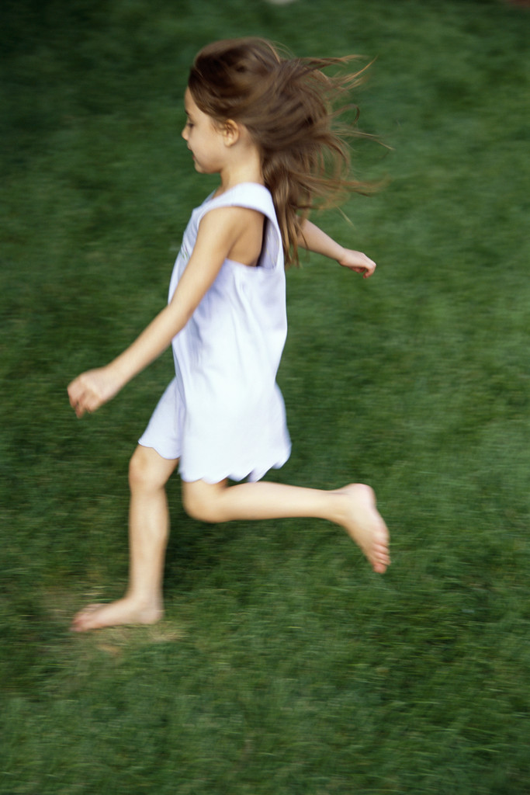
What is the girl doing?

Slide 17
She is running.

Slide 18
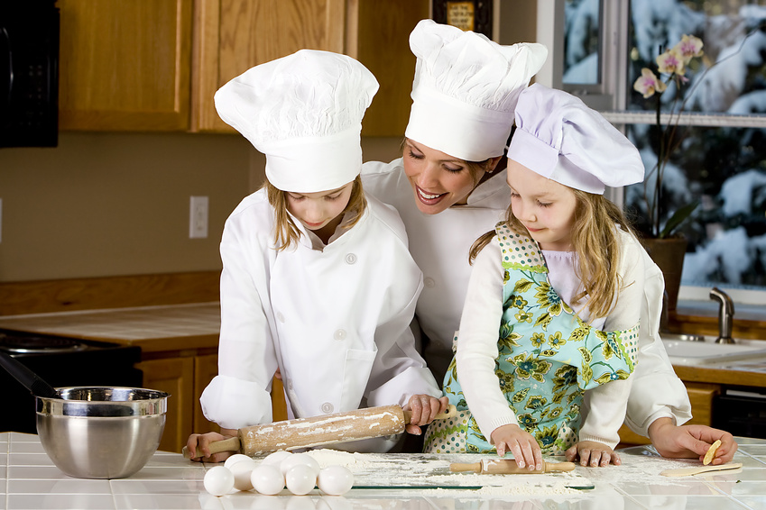
What are the girls doing?

Slide 19
They are cooking.

Slide 20
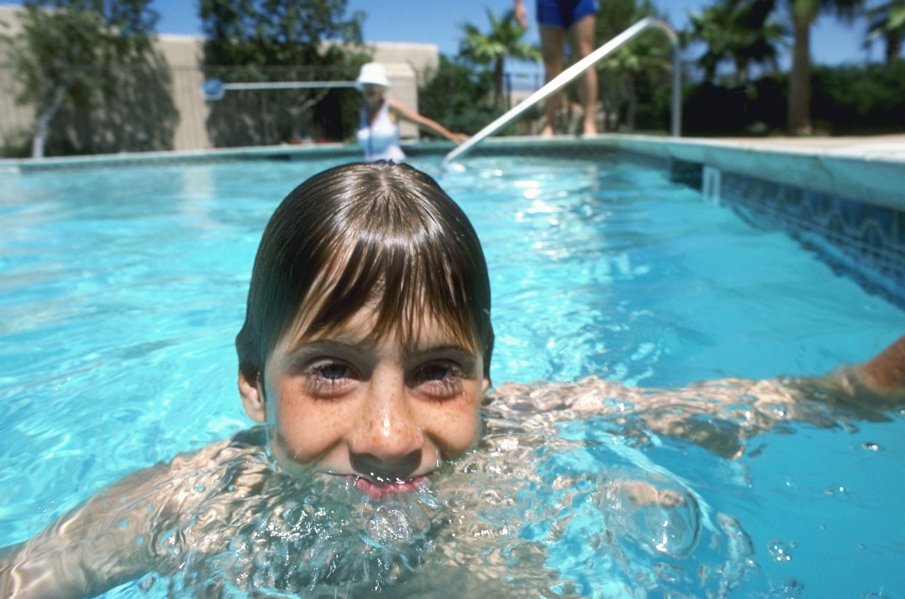
What is the boy doing?

Slide 21
He is swimming.

Slide 22

Read Datu’s email to his e-pal and then write your own email or make a poster
Hello Omar!
How are you? Is your school closed too because of the Coronavirus? We are at home with my family. I do many things to spend my time at home. Now, I am playing an online game for maths. My sister is cleaning her room and my little brother is watching a documentary film on National Geographic. My mother is cooking lunch and my dad is reading the news on his tablet.
What are you doing now?
Miss you
Datu

Slide 23
Write an email to your e-pal and write what you are doing
LET’S BE CREATIVE…

Slide 24


LET’S BE CREATIVE…
I am singing now!
        OR make a poster and write what you are doing now

Slide 25

IMAGES COURTESY OF :
https://www.twinkl.com/
https://www.memrise.com/
https://www.clipart.email/

