Slide 1
What pets have you got?

Slide 2
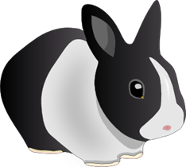
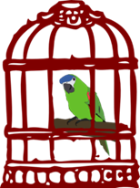
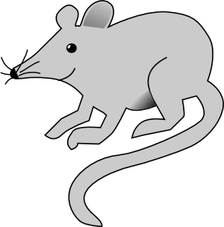
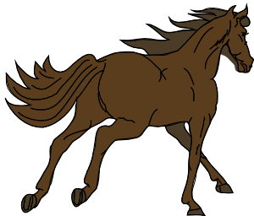
Listen, look and say
frog
rabbit
parrot
mouse
cat
fish
horse
dog

Slide 3
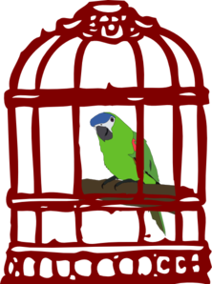
Let’s read!
I’ve got a parrot. What have you got?
I’ve got a cat. I like cats!

Slide 4
Let’s read!
I’ve got a rabbit. What about you?
What pet have you got?
I’ve got a cat. Have you got a cat, too?
No, I haven’t.

Slide 5
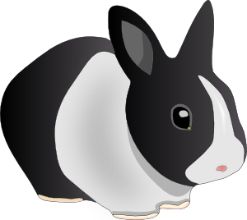
Complete the sentences in your notebook.
I’ve got a _______
I haven’t got a dog.
I’ve ____ a rabbit.
I ________ a frog.
______ a dog.
I haven’t got a _____.

Slide 6
What pet have you got?
I’ve got a ……………

Slide 7
Let’s play!
http://www.quia.com/rr/1409893.html
https://learnenglishkids.britishcouncil.org/word-games/pet

Slide 8
Write the correct words in your notebook.
rfog
tibbar
toprar
esuom
tac
hsif
esroh
god

Slide 9
Answer the questions with:
Yes, I have. No, I haven’t.
Have you got a parrot? ……………………………………
Have you got a red pencil? ……………………….......
Have you got a horse? …………………………………………
Have you got a brother?......................................

Slide 10
1.Read about Tom’s pet, Rocky.
2. Draw Rocky in your notebook.
I ‘ve got a big dog! His name is Rocky. It’s black and white. It’s got brown eyes, a small, black nose and big ears. I love my dog!
3. Draw a picture and write about your pet (or imaginary pet).
You can then send it to your teacher!

Slide 11
Images courtesy of:

