Slide 1
WE STAY HOME We protect ourselves and others
Dear children,
During the past weeks our lives have changed. A new coronavirus called COVID-19 is spreading across the world. Kids like you are wondering, "Why is school closed?" "Should I be worried about getting sick?" “What should I do to protect myself and my family?” Today, we will try to answer some of your questions and talk about how you can protect yourselves and others from the virus.
Let’s begin…

Slide 2
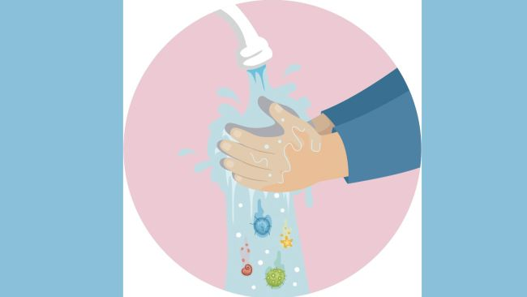
Read about Coronavirus. Then you will play a memory game. Find out: 1. What is the name of the virus? 2. What exactly is the virus? 3. Why is it called “Coronavirus”? 4. Where did the virus come from ? 5. How does the virus get into our body?

Slide 3
Based on the article:The ultimate kids' guide to the new coronavirus (from : https://www.livescience.com/coronavirus-kids-guide)
What is a virus?
A virus (ιός) is much smaller than anything you can see. Viruses can make us sick, if they get into our cells (κύτταρα).

Slide 4
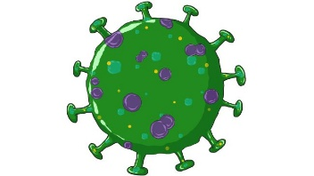
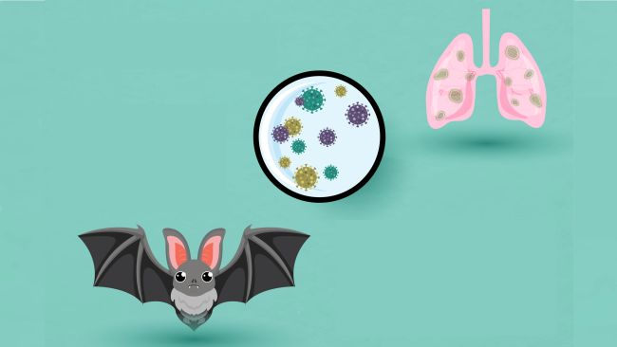
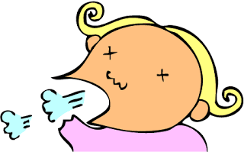
What is COVID-19?
Where did COVID-19 come from?
There is a new kind of coronavirus spreading around the world. It's called a coronavirus because "corona" means "crown" in Latin and the virus looks like it’s
wearing a crown The new virus is called COVID-19.
This virus makes people cough
feel tired
and have a fever
.
It was first found in a city in China, called Wuhan, last December. Scientists think the virus might come from bats. From there it, maybe, hopped into another type of animal, who gave it to humans.
bat

Slide 5
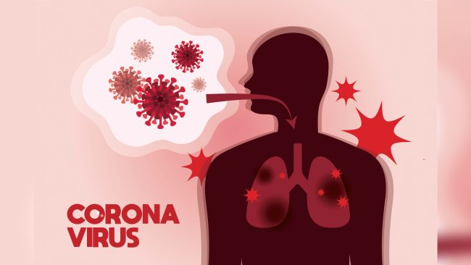
How does it make people sick?
Viruses make people sick by killing human cells or making them not work properly. The new coronavirus uses a special door to get into cells through the nose and lungs.
Lungs

Slide 6
Let’s see what you remember about Coronavirus..
GOOD LUCK!
Answer the questions on the link below:
http://www.quia.com/quiz/7663297.html

Slide 7
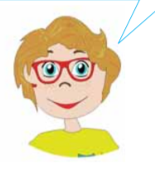
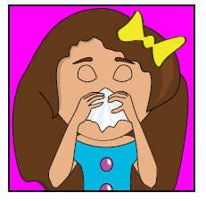
How can I protect myself and others from Coronavirus?
Let’s give some advice…
We give advice by using should or shouldn’t :
FOR EXAMPLE:
You should go to the doctor! You shouldn’t have cold drinks!!
I’ve got a cold!

Slide 8
Let’s practise should/shouldn’t with a game… https://wordwall.net/resource/547513
(Image credit :Webstockreviewnet.com)

Slide 9
What can I do to help? WATCH THE VIDEO to see what we should do: https://www.youtube.com/watch?v=WKS_WMwis9k
(Image credit :shutterstock)

Slide 10
BE CREATIVE … Make a poster about what we should and shouldn’t do to protect ourselves from COVID-19 Look at the following example:
(Image credit :Webstockreviewnet.com)

Slide 11
LET’S ALL HELP….
POSTER EXAMPLE
WE SHOULD STAY AT HOME
WE SHOULD WASH OUR HANDS OFTEN

Slide 12
Did you enjoy the lesson today?

Slide 13
IMAGES COURTESY OF :
https://www.Webstockreviewnet.com
https://covid19.govt.nz/
https://www.shutterstock.com
Webstockreviewnet.com

