Slide 1
Year 5
Comparatives and Superlatives

Slide 2
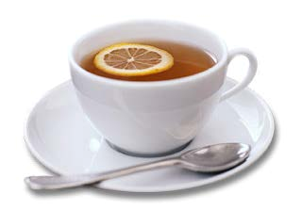


Let’s compare two adjectives
hotter

Slide 3



longer

Slide 4

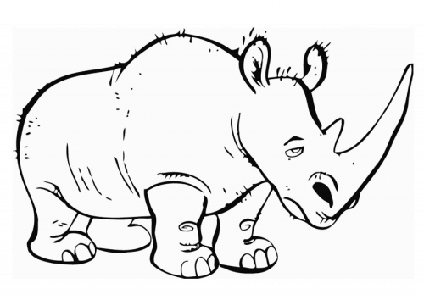
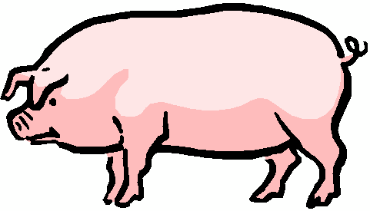
Now, let’s compare three adjectives
big
bigger
the biggest

Slide 5



tall
taller
the tallest

Slide 6
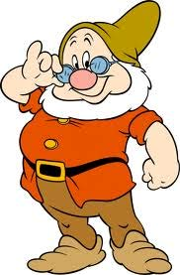
small
smaller
the smallest

Slide 7
Some adjectives have a different form…
B
B+
A
good
better
the best

Slide 8
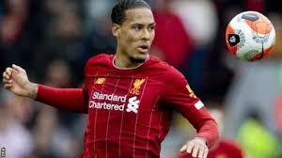
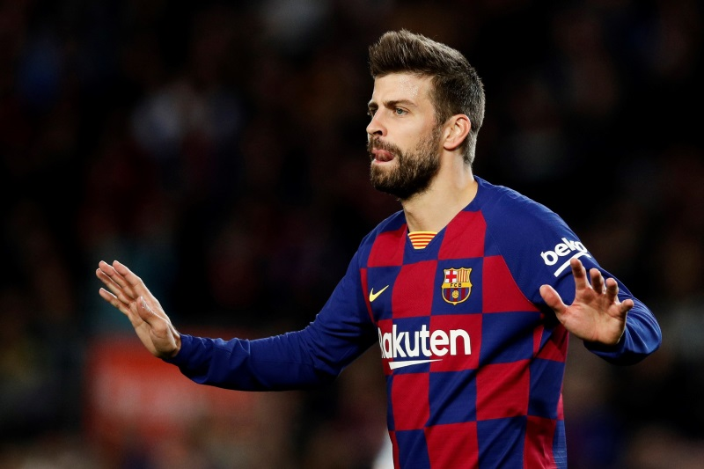
Van Dijk is a better football player than Pique.

Slide 9
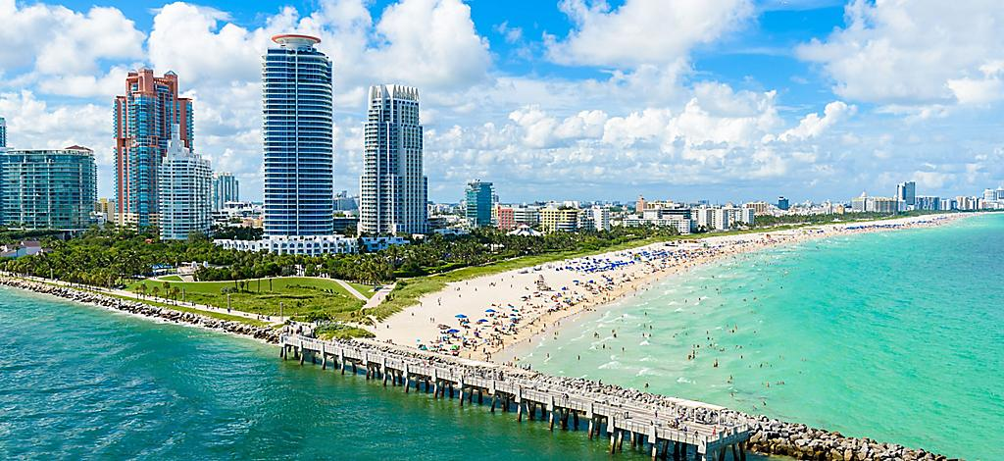
Florida is the hottest state in America

Slide 10
Useful links
http://angld.schools.ac.cy/index.php/el/materials/teach-material-year-5
( Power Point Presentations, Year 5, Unit 6, lessons 4 and 5)

Slide 11

Let’s play!
Click on the link below:
http://www.quia.com/pop/740022.html
https://www.quia.com/cm/770406.html
https://www.quia.com/jg/2682716.html

Slide 12
More games…
http://www.eslgamesplus.com/comparativessuperlatives-esl-grammar-nature-world-geography-vocabulary-fun-game/
http://gamestolearnenglish.com/compare/

Slide 13

Creative ideas…
Explore the Guinness World Records website
https://www.guinnessworldrecords.com/records/
Choose one interesting thing
Write one or two sentences about it
OR
Choose an adjective you like
Write the comparative and superlative form
Make a drawing for each

Slide 14

Well done!

